Slide 1
secure data hiding in images using steganography
CAPSTONE PROJECT
Presented By:Namratha Cheepurupalli
Student Name : Namartha Cheepurupalli
College Name & Department : vignan’s institute of engeineering for women&CSE(cyber security)

Slide 2
OUTLINE
Problem Statement
Technology used
Wow factor
End users
Result
Conclusion
Git-hub Link
Future scope

Slide 3
Problem Statement
With increasing digital communication, ensuring data security is crucial. Traditional encryption methods make messages unreadable but noticeable. Steganography solves this by hiding messages inside images, making them undetectable. This project aims to develop a Flask-based web app that allows users to embed and extract hidden messages from images while maintaining their quality. The app will support PNG & JPG formats, use LSB (Least Significant Bit) steganography, and provide a user-friendly interface for secure communication. The goal is to enable safe, covert data exchange without drawing attention

Slide 4
Technology used
Libraries :
1.tkinter – For the graphical user interface (GUI).
2.filedialog & messagebox (from tkinter) – For file selection and showing messages.
3.Pillow (PIL) – For image processing (handling PNG images).
Platform:
1.Python – The programming language used.
2.VS Code, PyCharm, or IDLE – Can be used as the development environment.
3.Windows, macOS, or Linux – The script runs on any OS with Python installed.

Slide 5
Wow factors
Easy-to-Use GUI – Simple Tkinter interface, no command-line needed.
Lossless Image Encoding – Uses LSB technique without altering image quality.
Custom Delimiter – Ensures accurate message extraction.
Works with Any PNG Image – No format or size restrictions.
No External Storage – Message is hidden directly in pixels.
Cross-Platform & Lightweight – Runs on Windows, macOS, and Linux with minimal dependencies

Slide 6
End users
Privacy-Conscious Users – Individuals who want to hide sensitive messages in images.
Cybersecurity Enthusiasts – Learners exploring steganography techniques.
Forensic & Security Professionals – Analysts testing data-hiding methods.
Educators & Students – Teaching and learning steganography in a simple way.

Slide 7
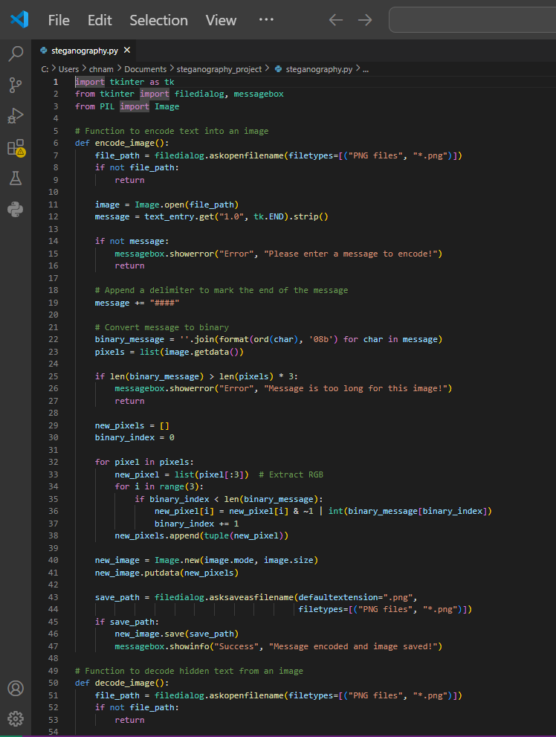
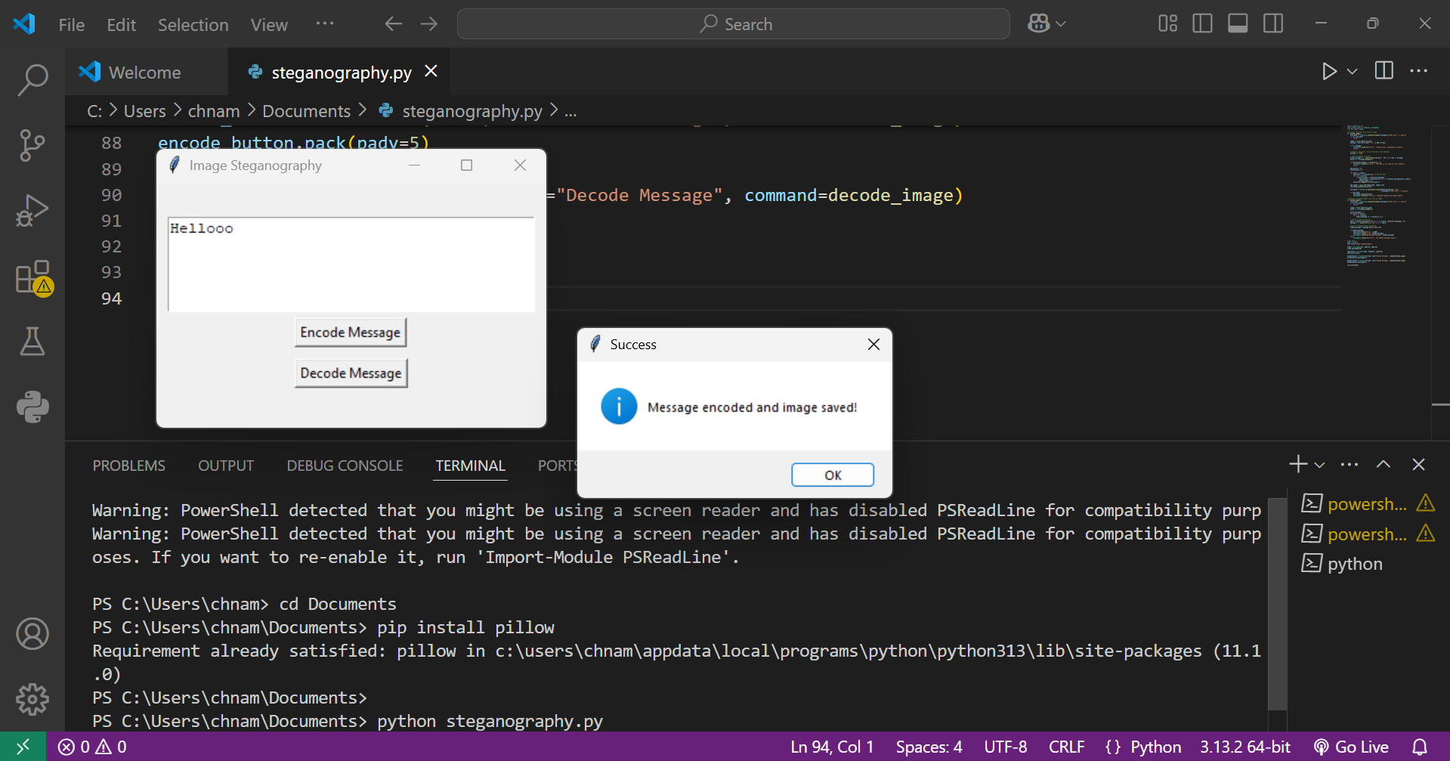
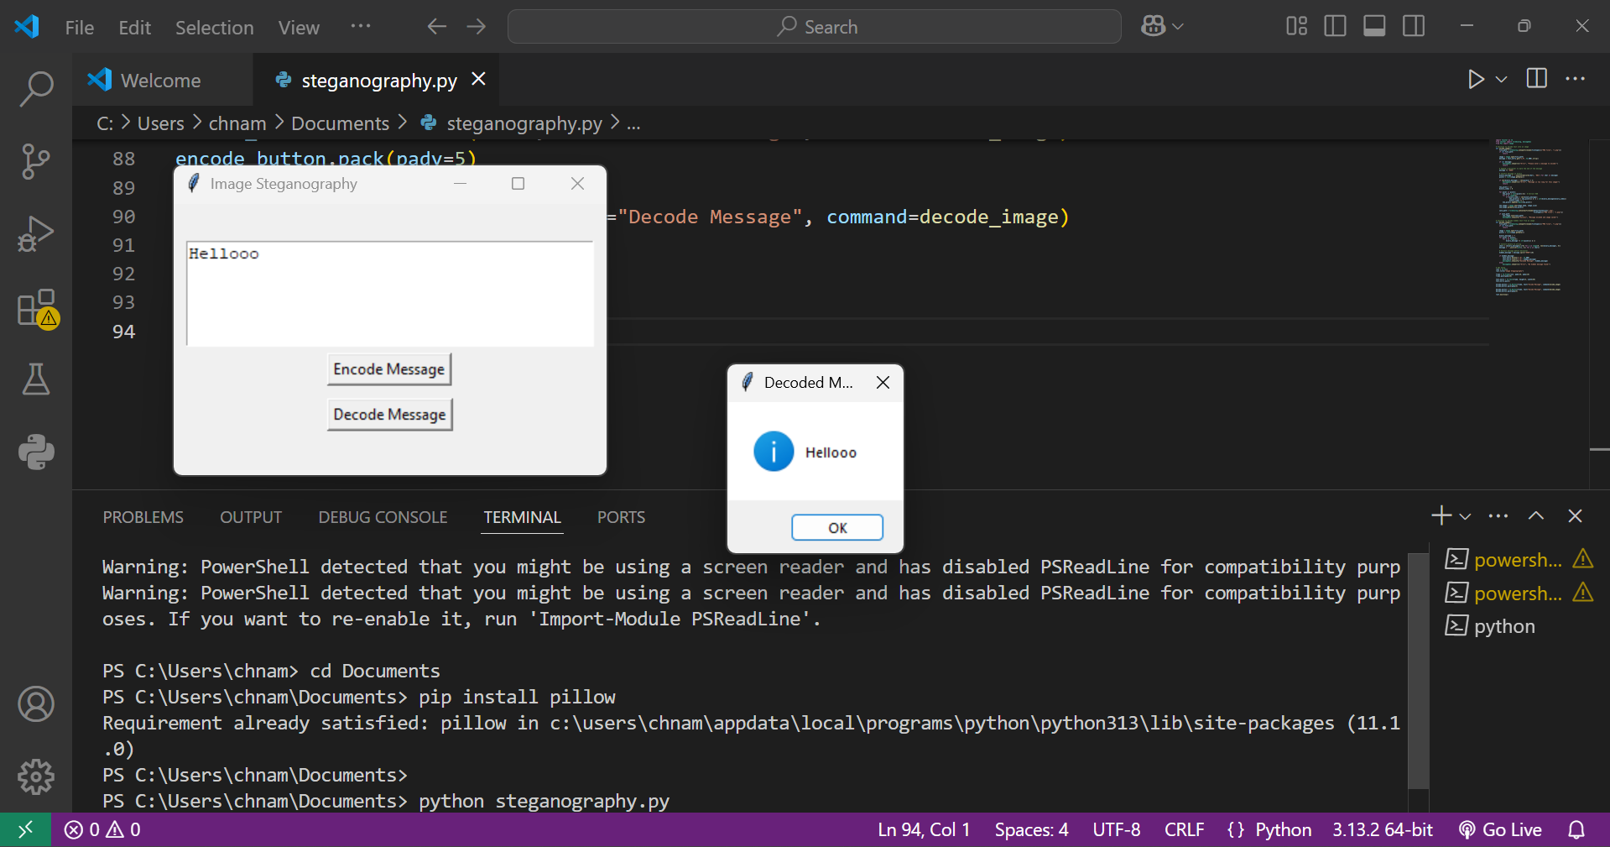
Results

Slide 8
Conclusion
This Image Steganography project provides a simple and effective solution for securely hiding messages within images using LSB encoding. It ensures privacy without altering image quality and offers an easy-to-use GUI for seamless encoding and decoding. Ideal for privacy-conscious users, cybersecurity learners, and educators, this tool demonstrates the power of steganography in digital security.

Slide 9
GitHub Link
https://github.com/namratha030/steganography_project.git

Slide 10
Future scope(optional)
This project can be improved by supporting more image formats like JPEG and BMP, making it more versatile. Adding encryption before encoding will enhance security, ensuring only authorized users can decode messages. A web or mobile app version can increase accessibility and usability. Additionally, AI-based detection prevention can help make hidden messages even harder to detect, improving privacy.

Slide 11
THANK YOU

